Slide 1
Contextualizing an unfamiliar city
Clustering LA then classifying NYC neighborhoods
based on nearby venues

Slide 2
Background
Moving to a new city is a difficult undertaking and can result in a lot of stress
Especially when you like the facilities and venues in your current accommodation
To make moving home easier, you need a reference point, where potential neighborhoods in the new city are compared to your current location
Imagine a real-estate / rental-listing website (such as zillow or realtor) being able to contextualize the potential neighborhoods based on their similarity of surrounding facilities to your current accommodation

Slide 3
Procedure
Los Angeles (USA) is selected as the current city and New York City (USA) is selected as the moving location. Then a three-step process is applied with the aim to make unfamiliar New York understandable by relating the neighborhoods to Los Angeles:
The neighborhoods of Los Angeles will be clustered based on their surrounding facilities.
These clusters will be used as labels to train a classifier.
The classifier will then be applied to New York City neighborhoods, providing context for the new city via analogy to the current residence.

Slide 4
Data
Neighborhood names and boundaries, as defined by the latitude, longitude coordinates of bounding polygons of the will be sourced from Neighborhood Data for Social Change for Los Angeles and New York Open Data for New York City.
The types of venues (categories) of the surrounding businesses and facilities in each neighborhood will be sourced from the Foursquare Places API.

Slide 5
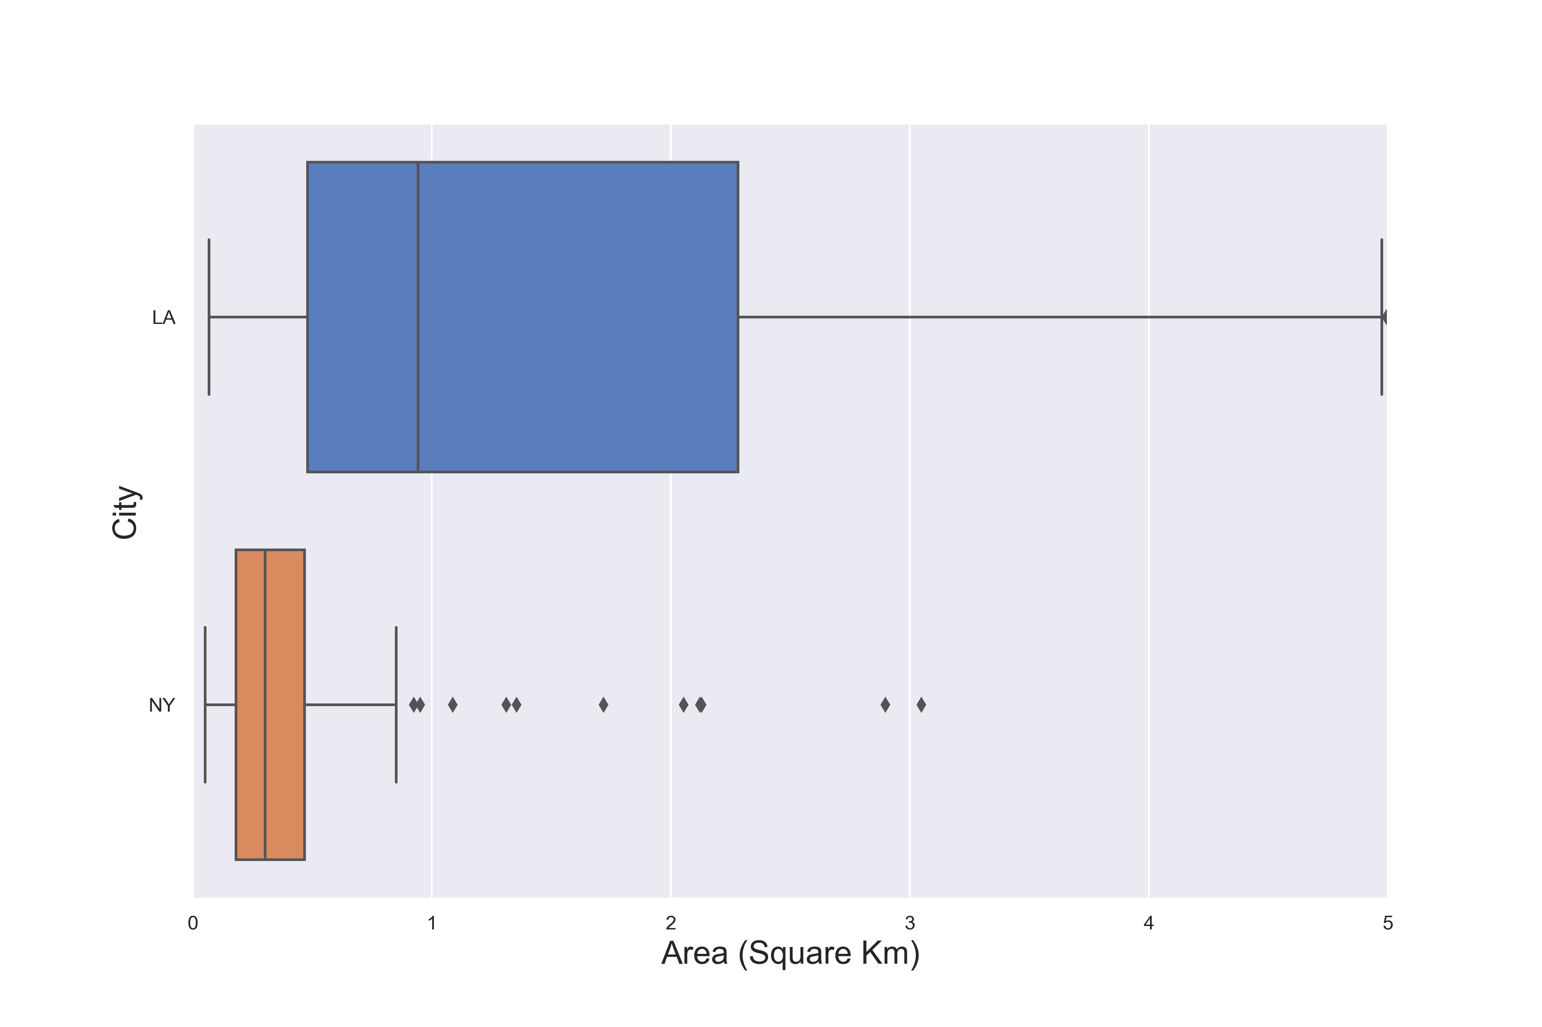
Exploration: Outliers in LA Neighborhood Area

Slide 6
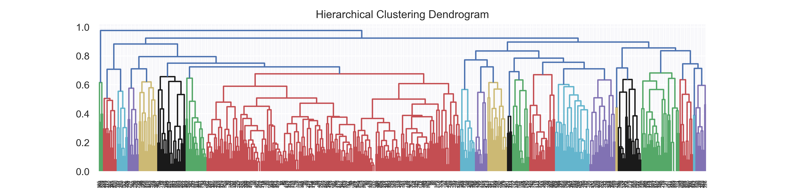
Venue Categories Clustered for Semantic meaning (semi-automated)

Slide 7
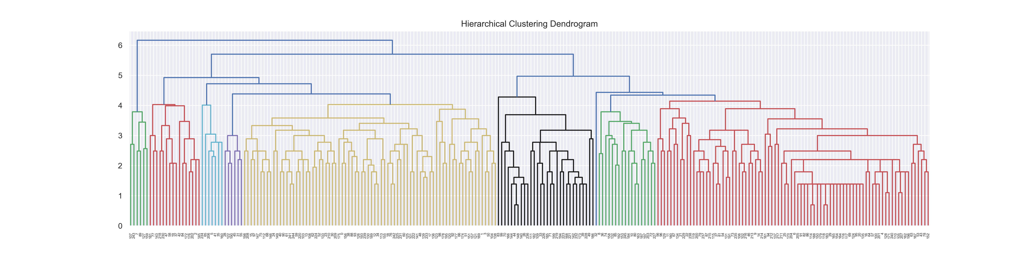
Clustering Los Angeles Neighborhoods

Slide 8
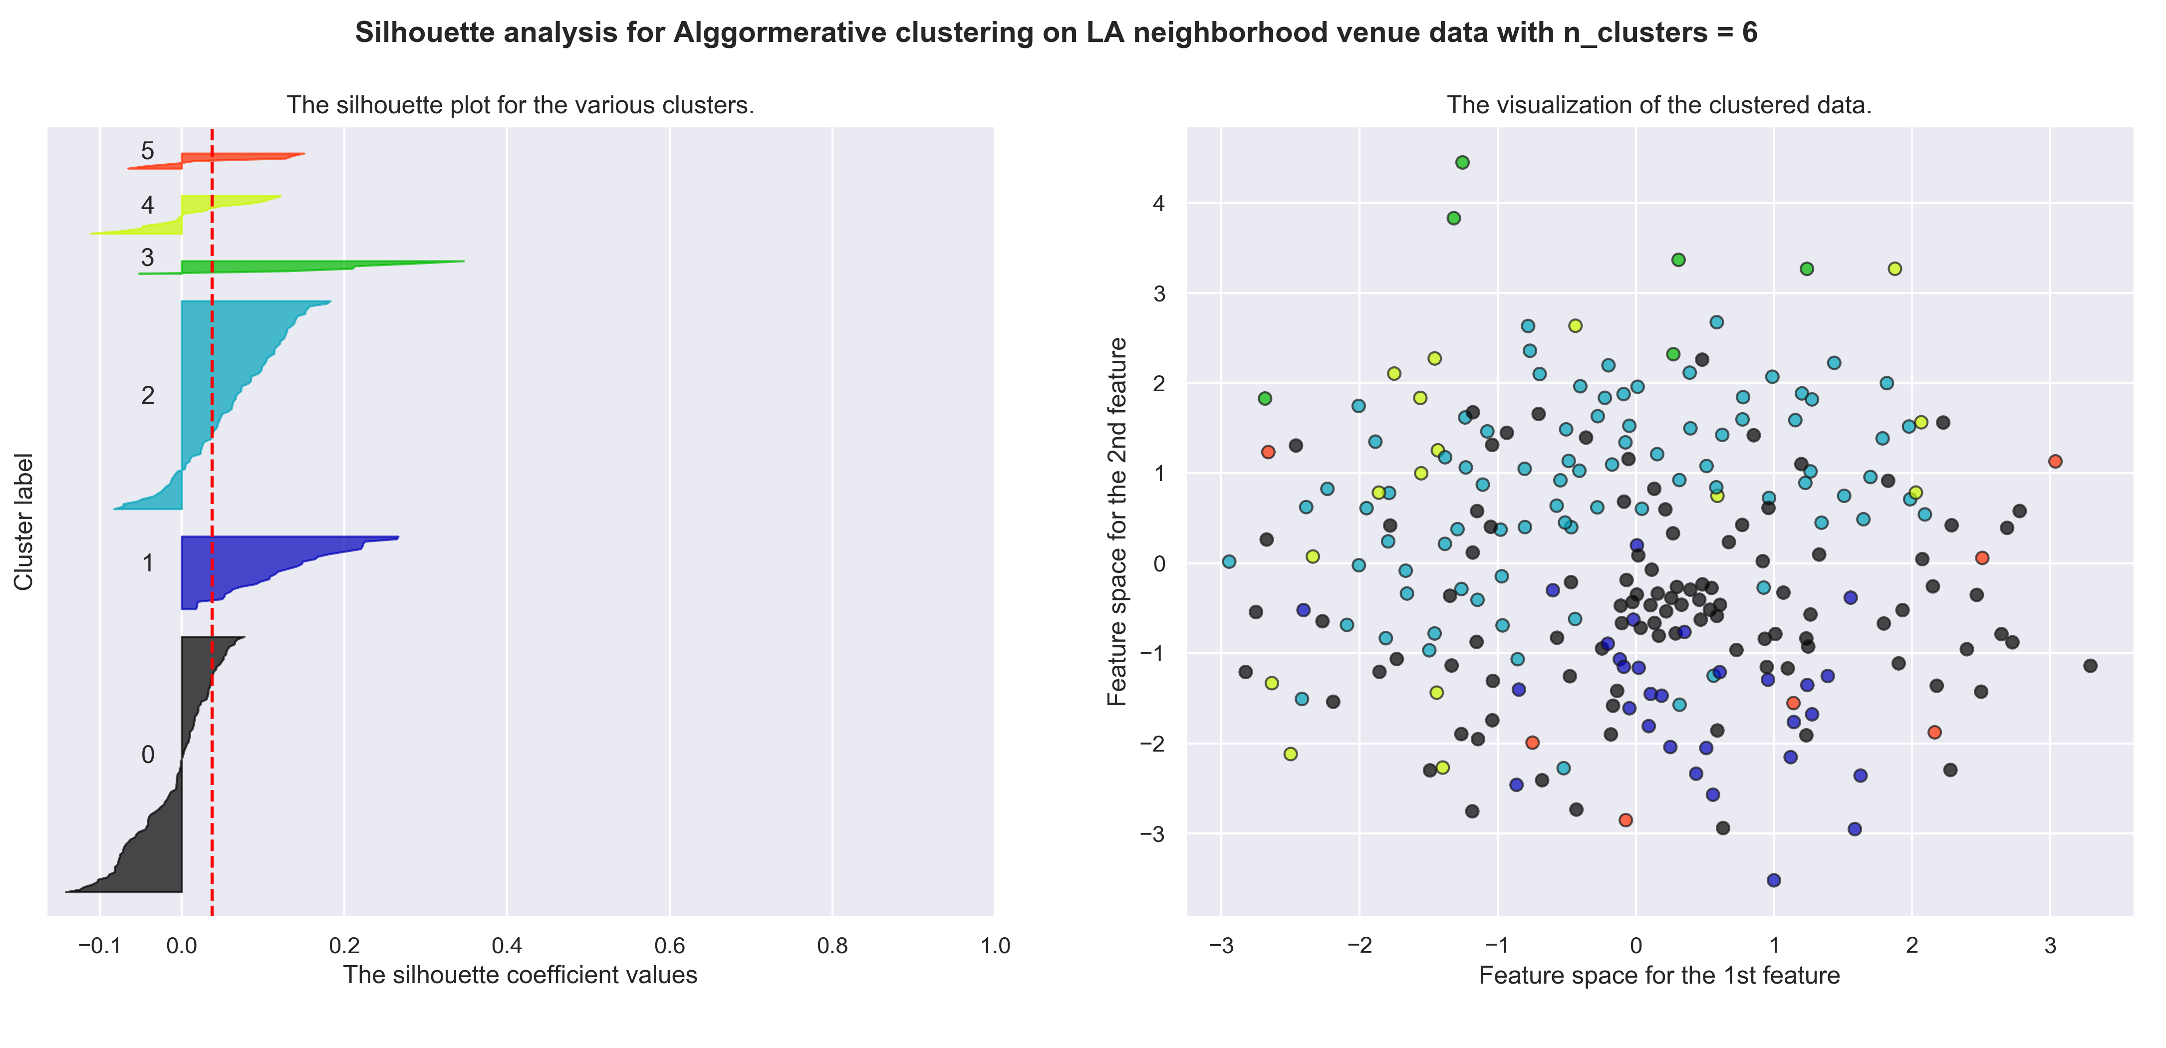
Best LA Cluster Number was Six

Slide 9
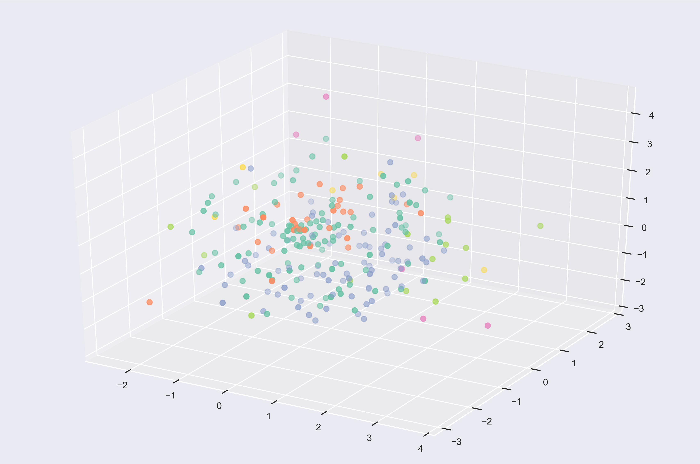
LA Clustering 3D embedding (Multi-Dimesional Scaling)

Slide 10
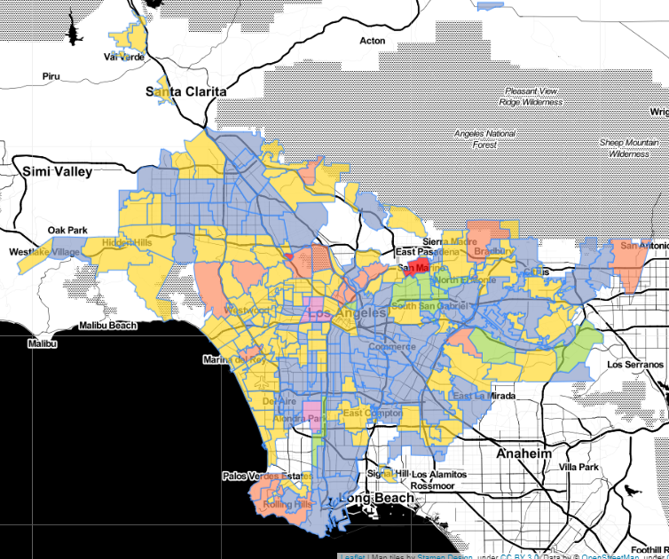
LA Neighborhood Clustering MAP (mix of venue types)

Slide 11
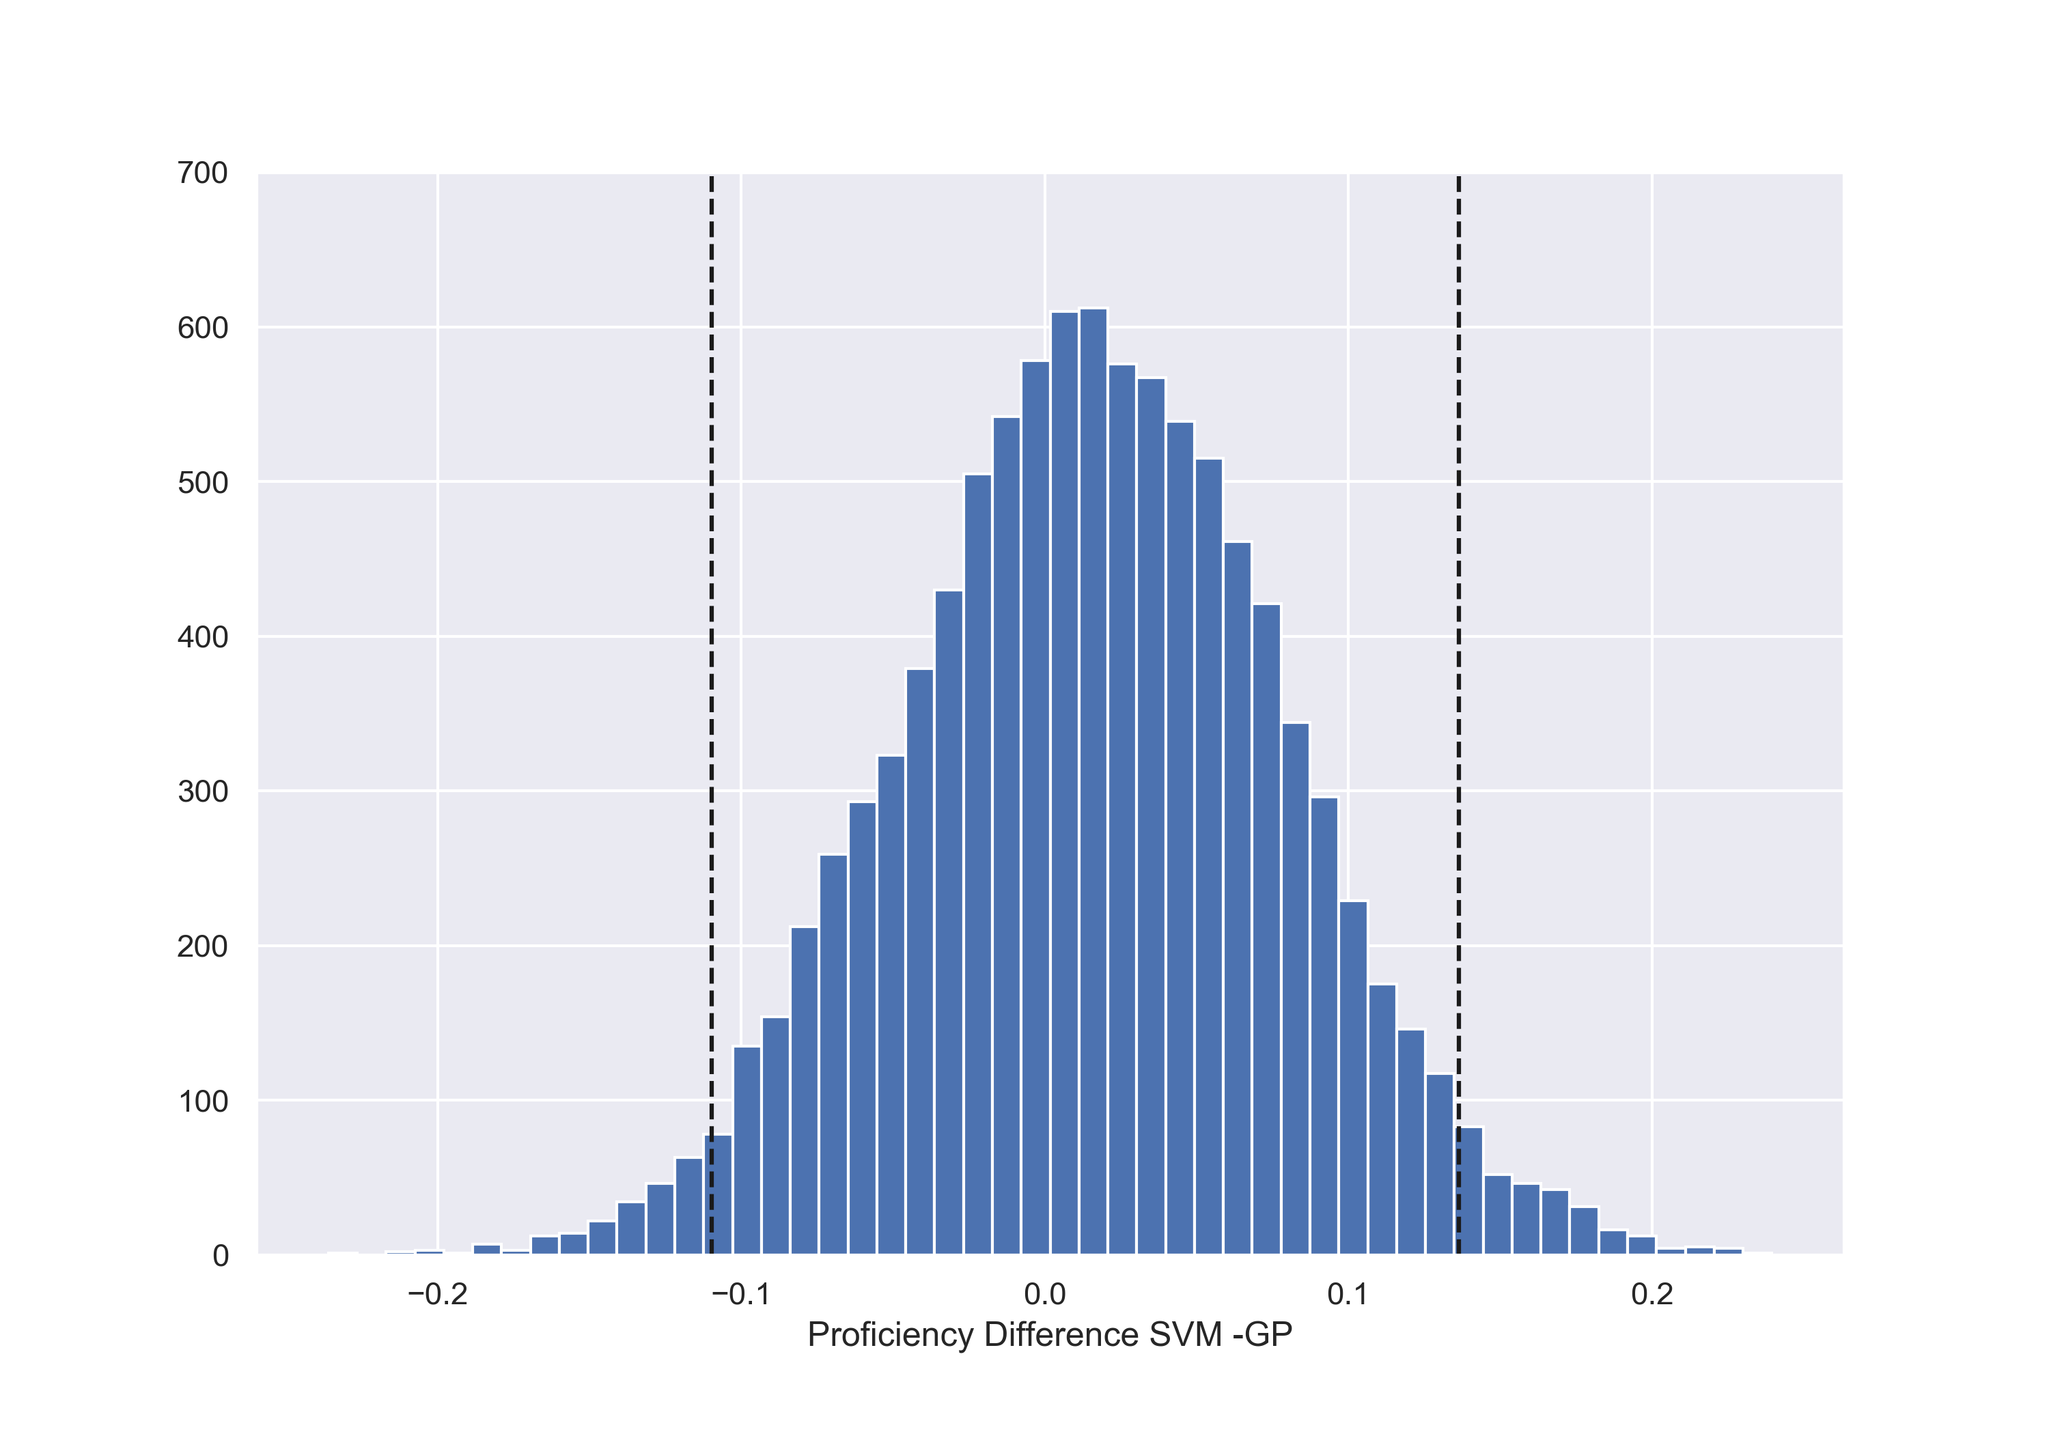
Training Classifiers on LA Clusters (Gaussian Process and Support Vector Machine Tied for Best)

Slide 12
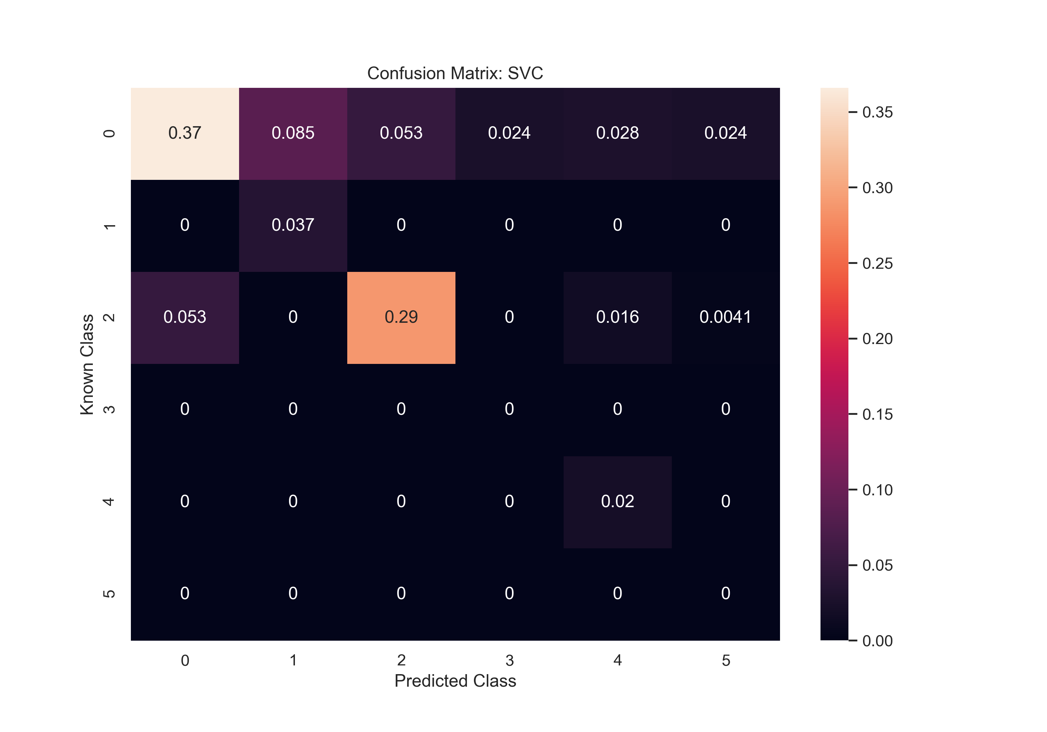
But SVM Confusion Mat shows it missed 2 classes

Slide 13
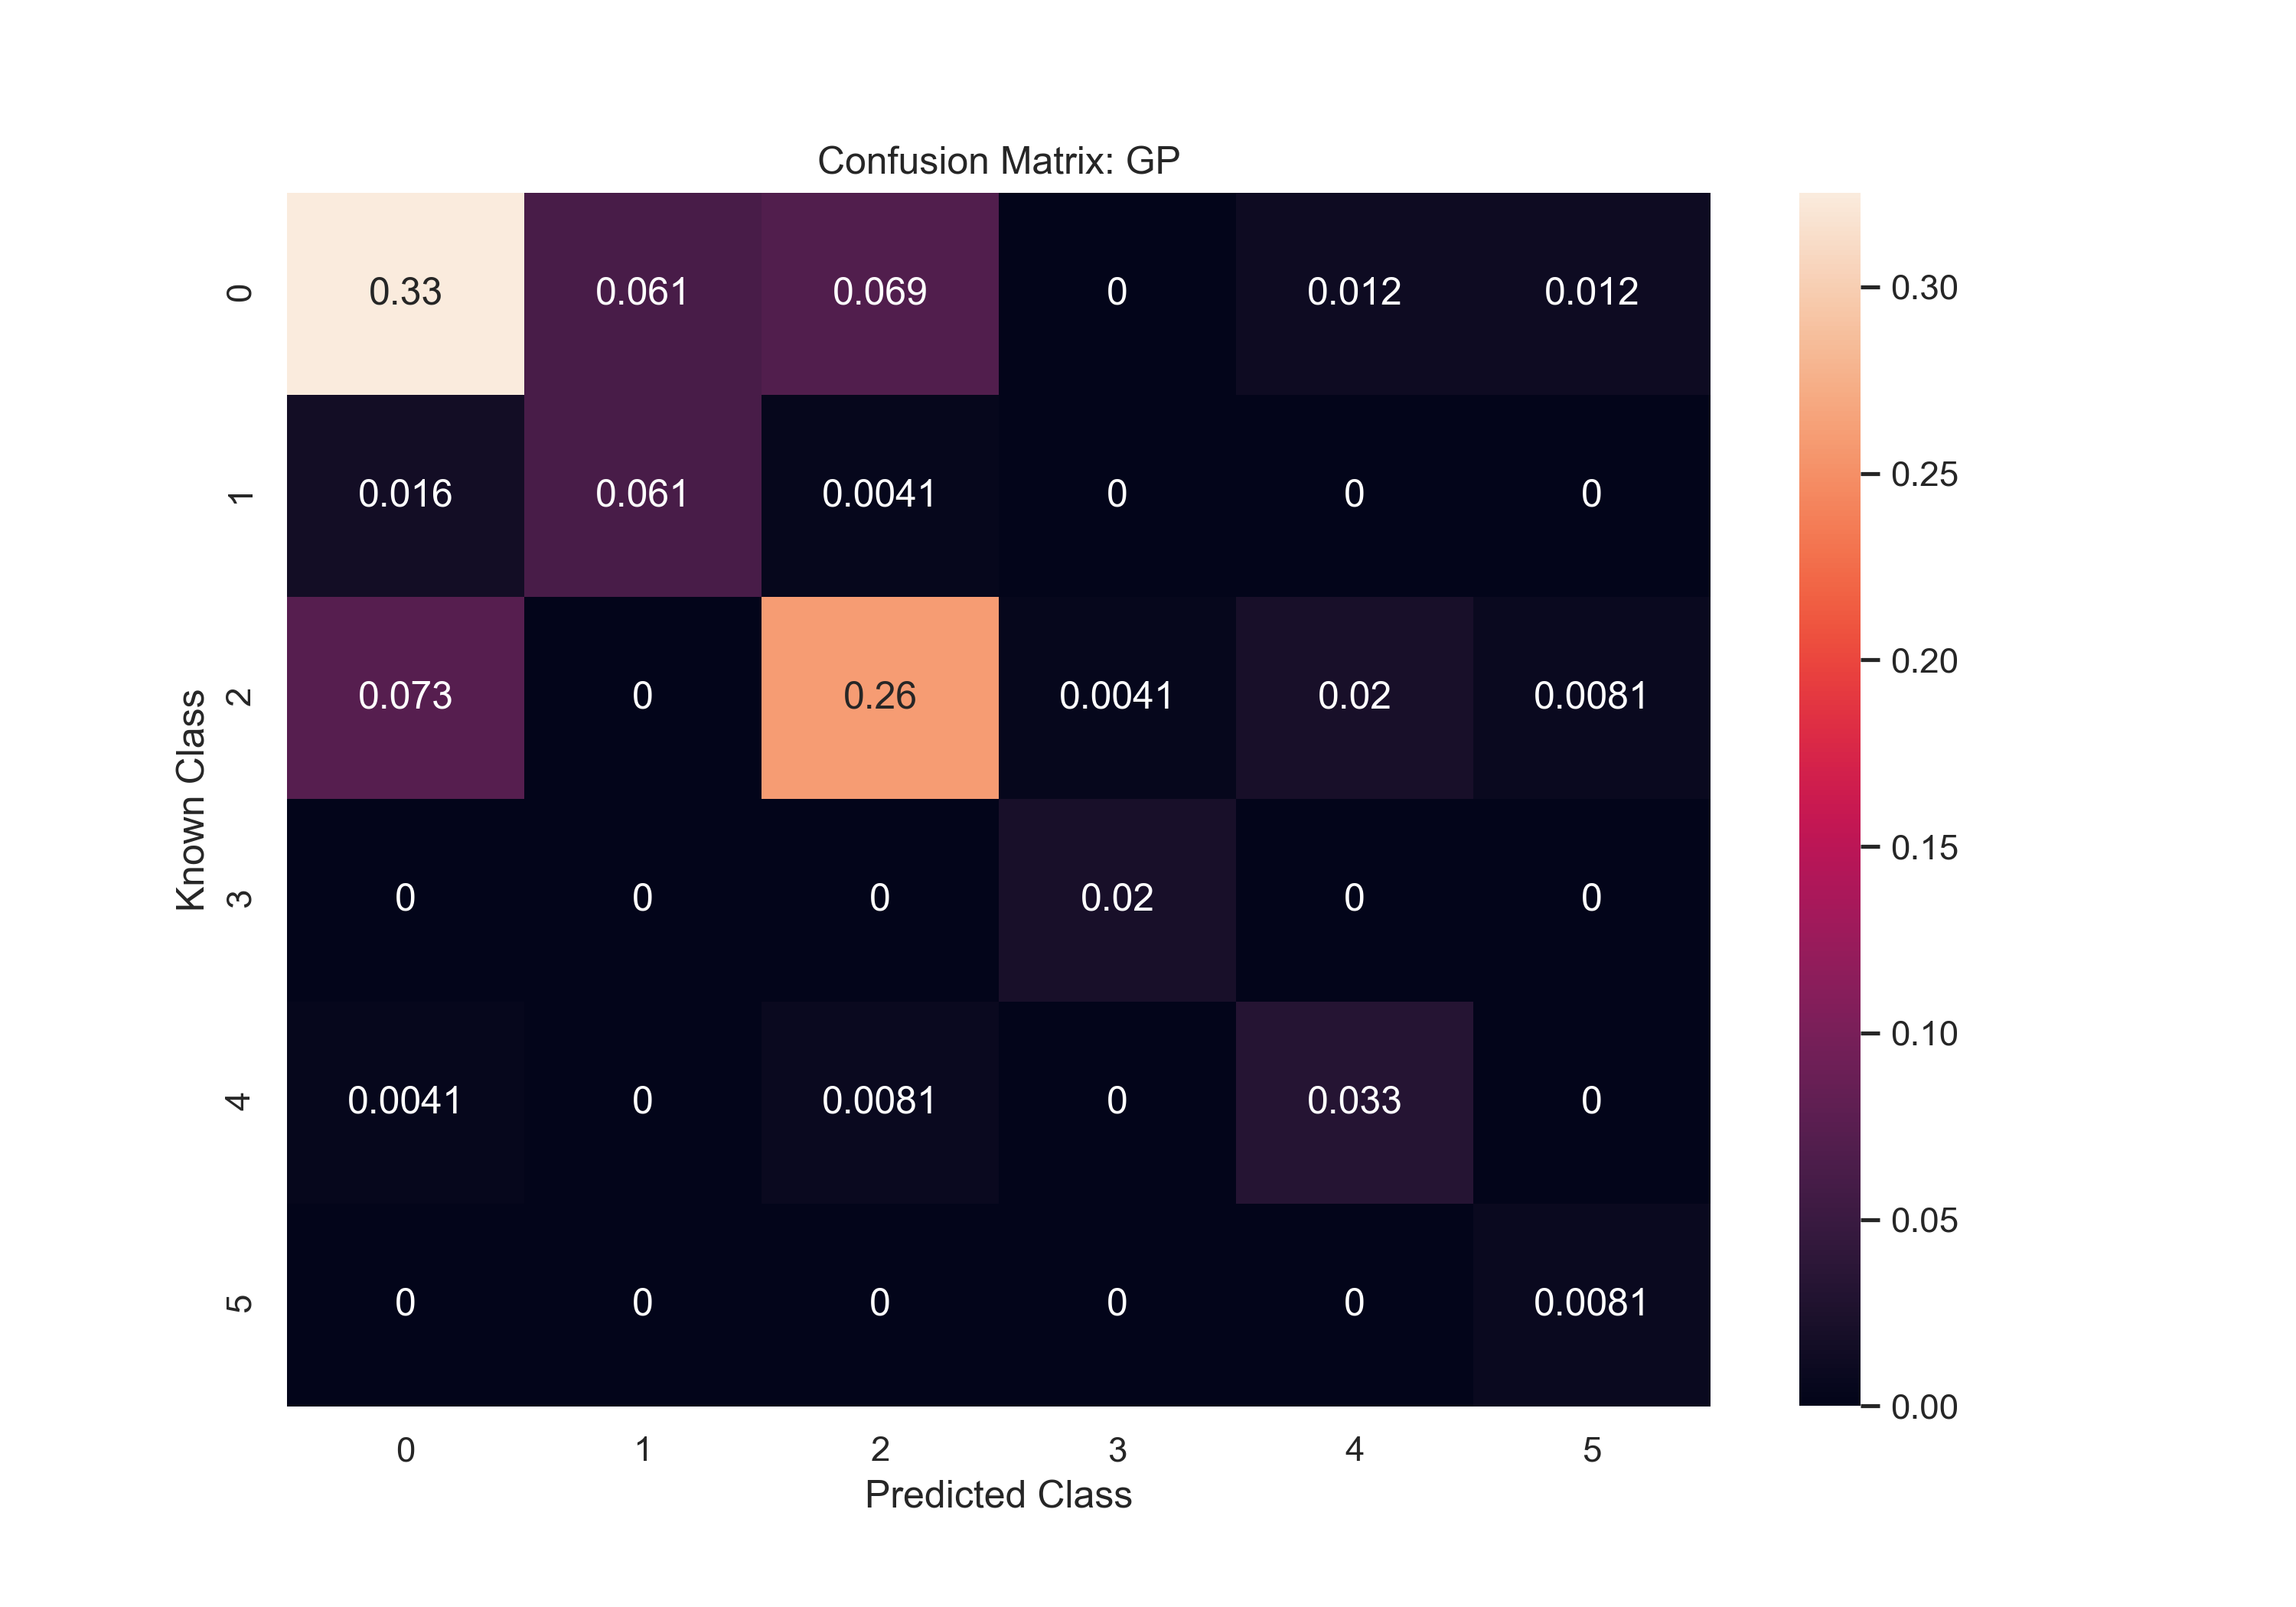
GP Confusion Mat confirms better classification for 2 classes

Slide 14
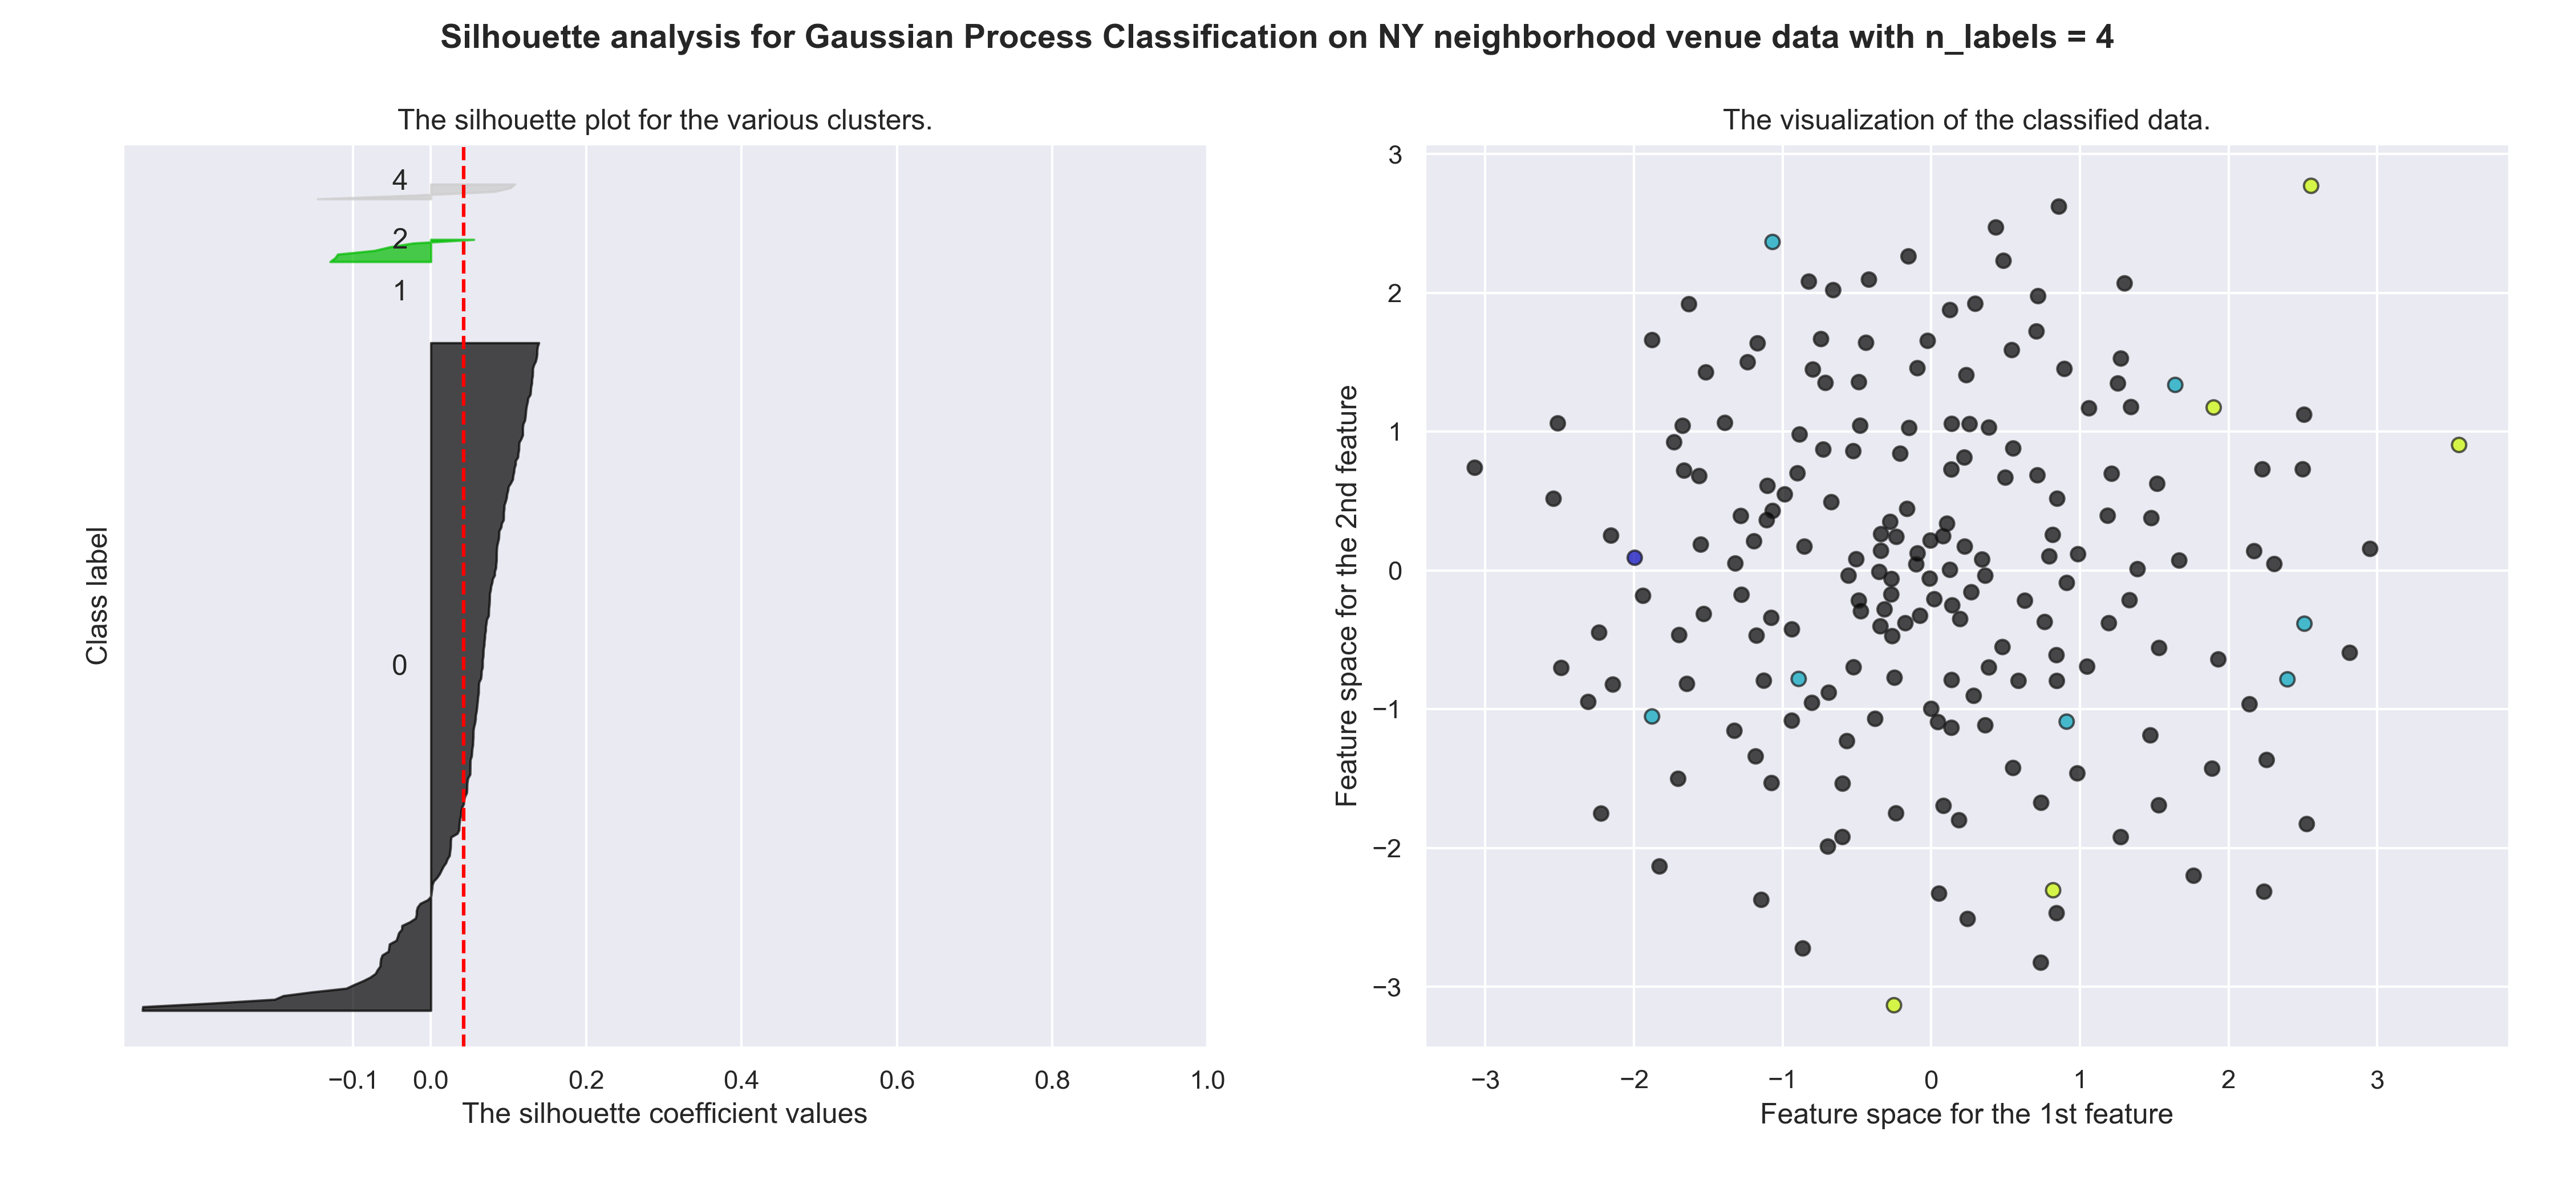
NYC Neighborhood Classification

Slide 15
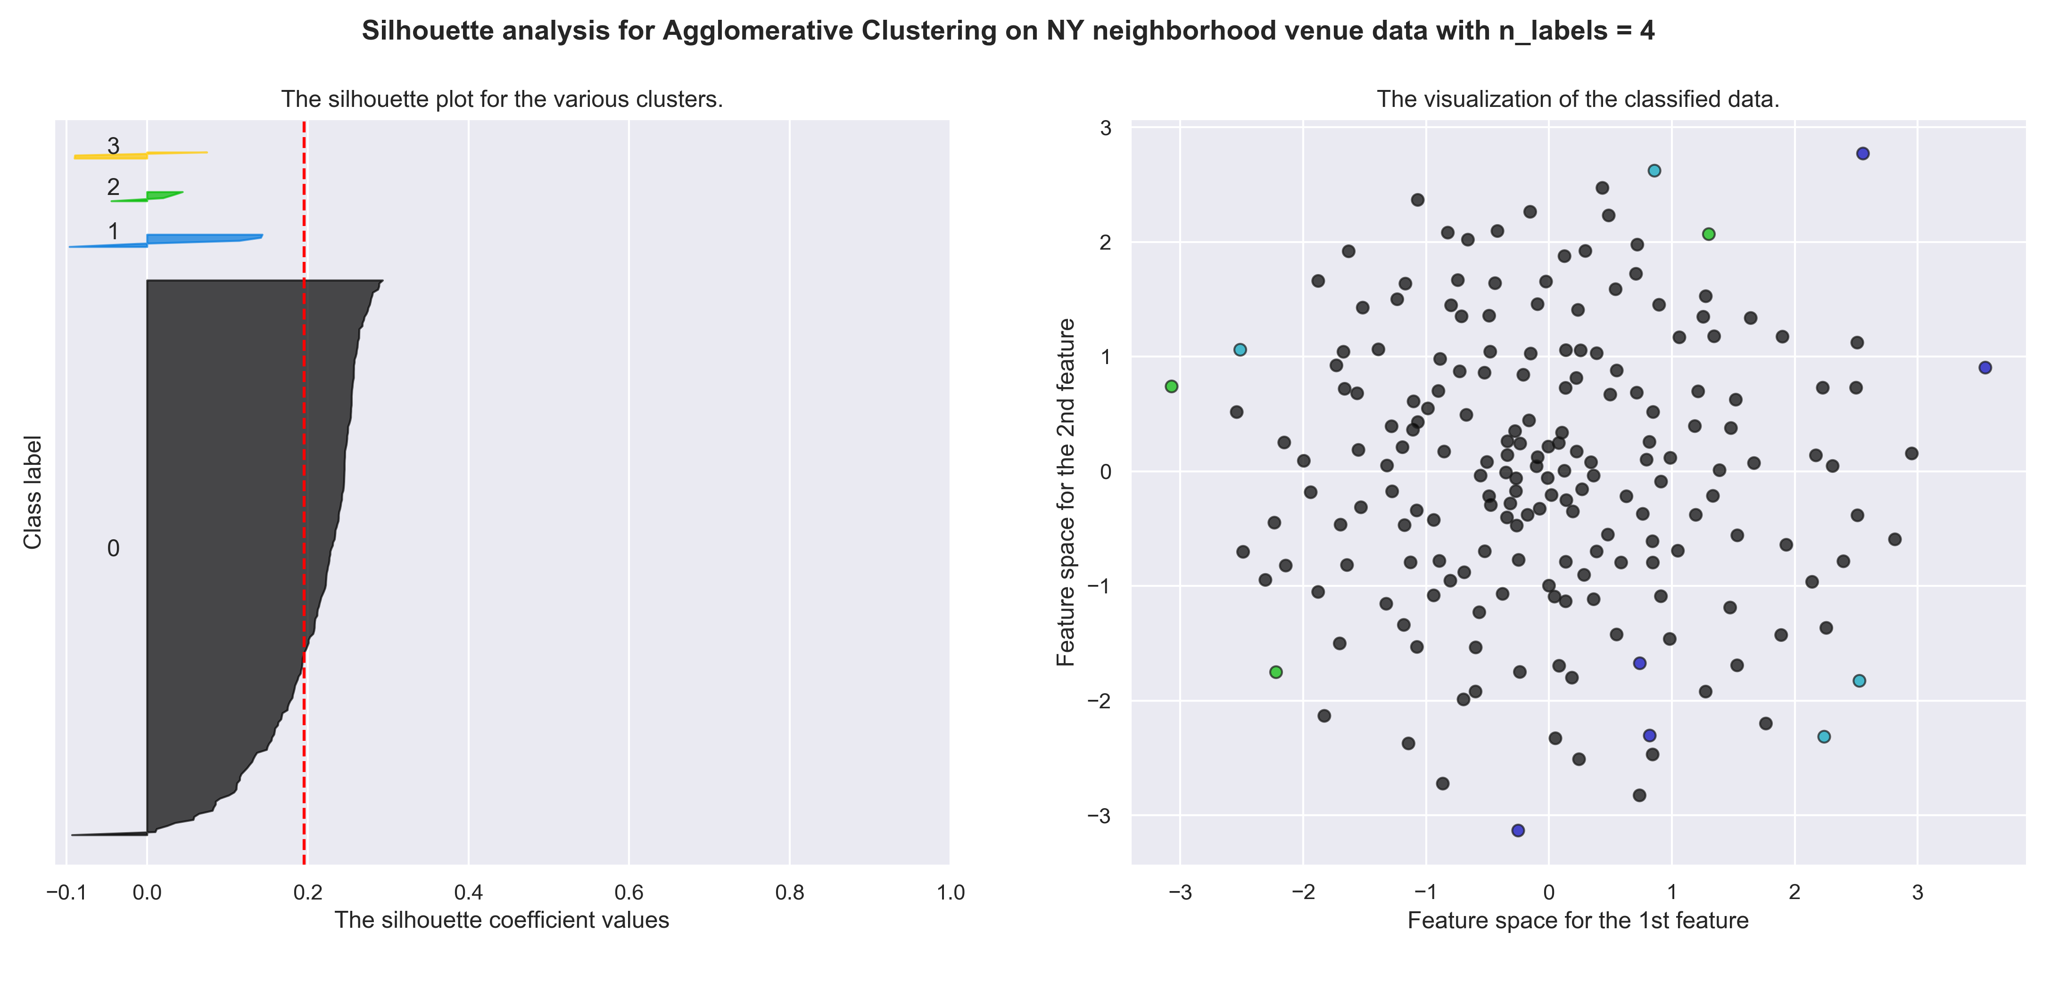
Similar Results to NYC Clustering

Slide 16
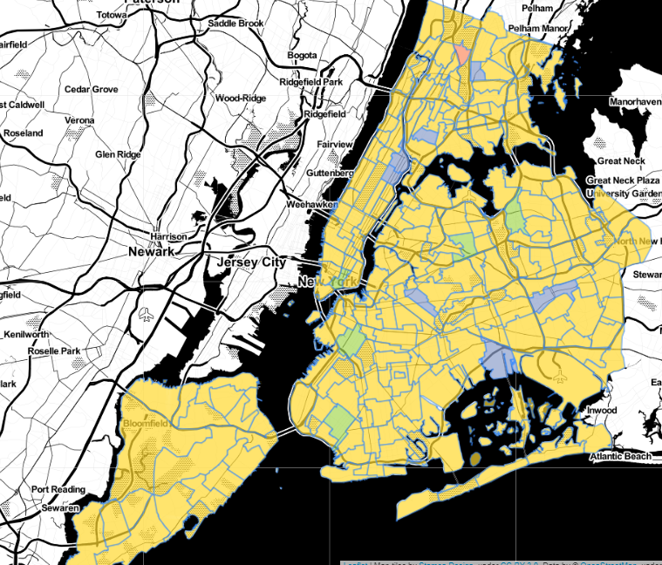
NYC Classified Neighborhood MAP (dominated by pizza places)

Slide 17
Conclusions and Further Directions
The approach was demonstrated to be successful with estimated classification accuracy of 70% for 6 classes and comparable results to direct clustering of the New York neighborhoods.
New York City neighborhoods were found to be much more homogeneous (Pizza Places everywhere)
Look at integrating other types of data for the clustering features, to give a more holistic comparison of neighborhoods between cities.
Use a different source for venue data, such as Google. Google venue information may be less biased to food-based venues than the foursquare social media data.
Local residents from each city could be recruited to assess the veracity of the clustering and classification.

